Slide 1
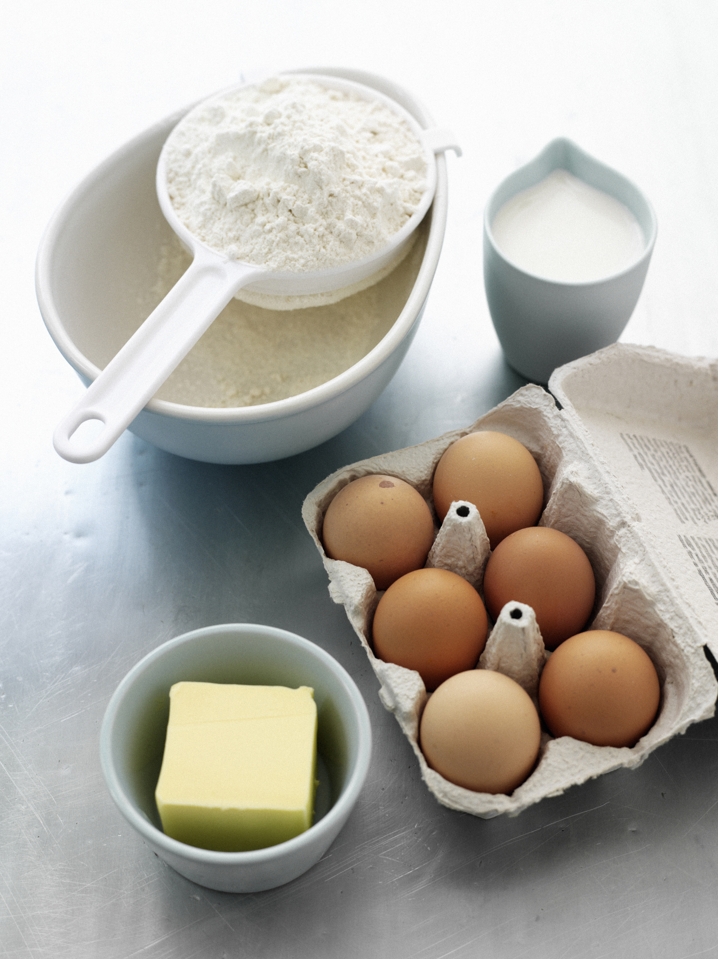
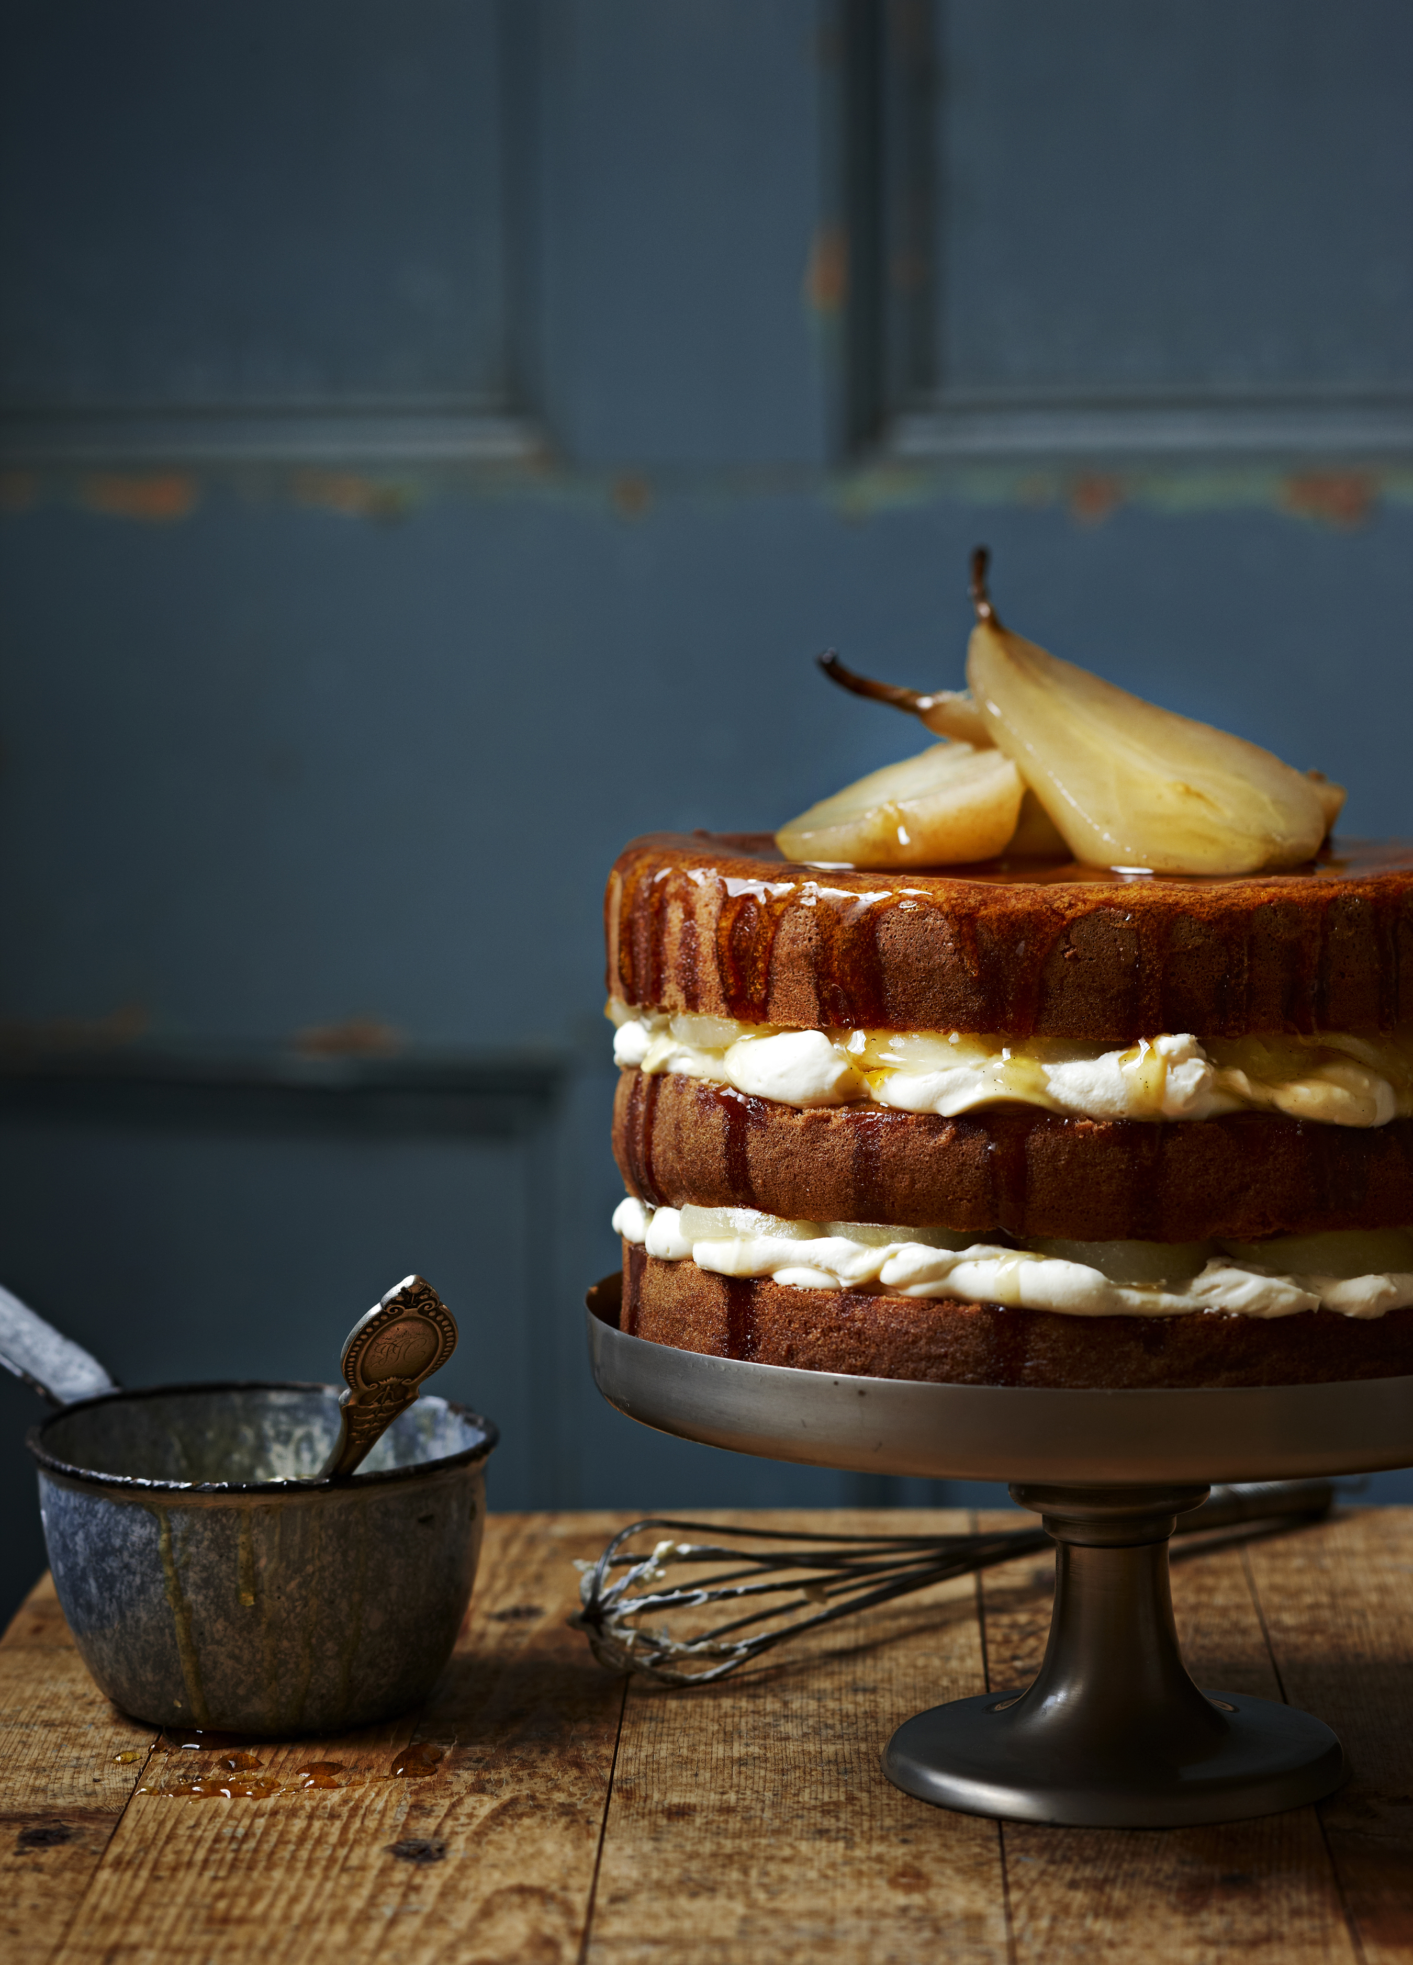
Principles of Design
How the Elements Work Together
Elements
Principles
Notes:
We have looked at the elements (ingredients) of design (line, shape, size, texture, colour, direction).
Today we start to look at the recipe: the principles that tell us how to arrange those ingredients.”
Principles help us create clarity, order, and emphasis.
When a design ‘just works,’ it’s because these principles are doing heavy lifting behind the scenes.
As we go, keep asking: What principle is at work? and How does it help the message?

Slide 2
Principles of Design
Balance:
Proximity:
Alignment:
Repetition:
Contrast:
Space:
Does the page feel stable or lopsided?
Are related things close together?
Do edges line up along an invisible grid?
Are you creating unity with consistent choices?
What stands out first? Why?
Is there breathing room, or is it crammed?
Notes:
These six are our core layout rules.
There are others you’ll meet later (like rhythm), but mastering these six will transform how you design and critique.
Think of them as questions to test your work:
Balance: Does the page feel stable or lopsided?
Proximity: Are related things close together?
Alignment: Do edges line up along an invisible grid?
Repetition: Are you creating unity with consistent choices?
Contrast: What stands out first? Why?
Space: Is there breathing room, or is it crammed?

Slide 3
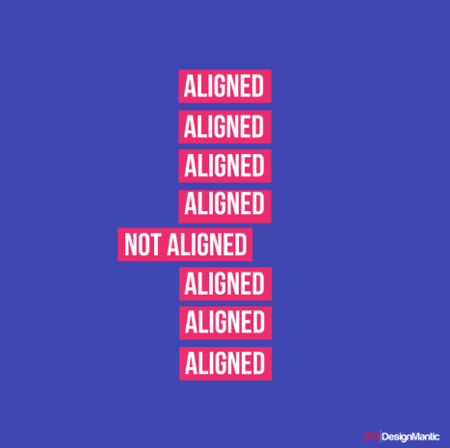
Alignment
Alignment is lining up edges along invisible lines (a grid). It creates order and visual connections between things.
Visual connection
Creates order
Improves readability
Notes:
Ask “Where do your eyes go first?” often—it trains hierarchy thinking.
Definition (say):
“Alignment is lining up edges along invisible lines (a grid). It creates order and visual connections between things.”
Why it matters:
“Viewers feel alignment even if they don’t see the grid. Misalignment feels amateur.”
“Aligned edges and baselines make long text more readable.”

Slide 4
Why Use a Grid?
A grid helps designers:
Organize information
Create consistency
Improve readability
Speed up decision making
Build professional layouts
Notes:
Most professional designers rarely place elements randomly.
Instead, they use a grid system as an invisible framework.
Think of a grid like the framework of a house.
You may not see it in the finished house, but it supports everything inside.
A grid helps designers:
Decide where text should go
Align images consistently
Create visual hierarchy
Maintain balance
Without a grid, layouts often feel disconnected or disorganized.
With a grid, viewers can understand information more quickly.

Slide 5
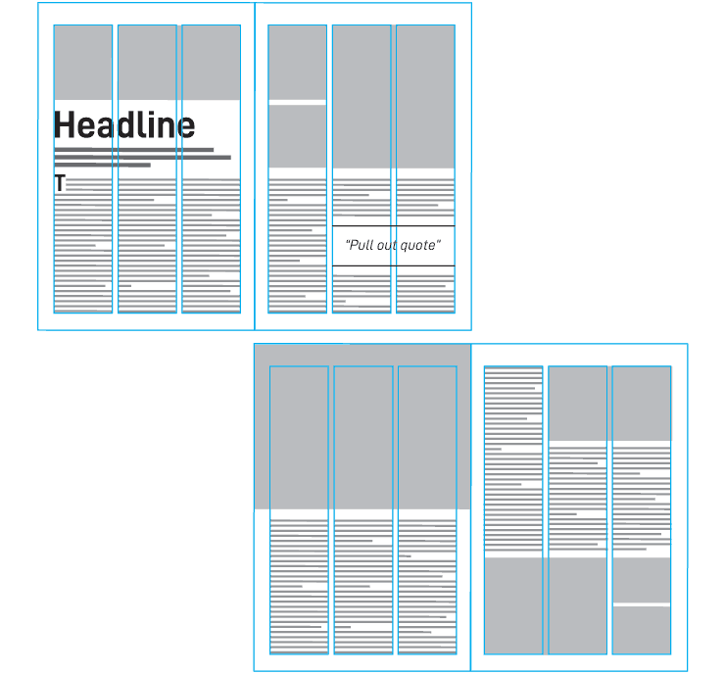
We See Grids Everywhere
Common Uses of Grids
Websites
Newspapers
Magazines
Packaging
Mobile apps
Social media templates
Notes:
Grids are everywhere.
Open almost any website and you'll find a hidden grid helping organize content.
Magazine layouts often use multiple columns.
Social media campaigns frequently use repeated grid structures to create consistency.
The goal is not to make everything look identical.
The goal is to create order that helps communication.

Slide 6
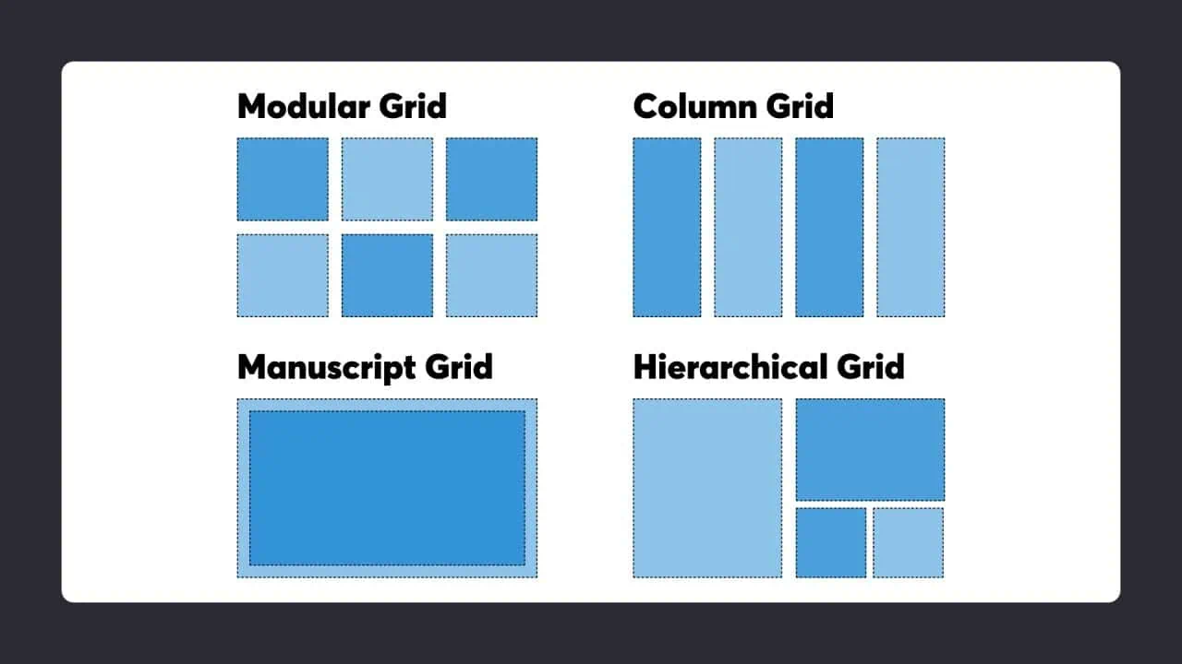
Grid Systems
Manuscript
Column
Notes:
A grid system is a structural framework of rows, columns, gutters, and margins used to organize visual content consistently across pages and screens.
Manuscript (Single-Column) – The simplest grid, it comprises a single column of text surrounded by margins. It’s the default for new documents in page layout programs, and typically appears in books where single columns of text appear in spreads (facing pages).
Column – These grids provide flexible formats for publications with a complex hierarchy or that integrate text and illustrations. The more columns you create, the more flexible your grid becomes. You can use the grid to articulate the hierarchy of the publication by creating zones for different kinds of content. A text or image can occupy a single column, or span several. Not all the space has to be filled.
Image from: © Daniel Skrok and Interaction Design Foundation, CC BY-SA 3.0
https://ixdf.org/literature/topics/grid-systems
https://sl.bing.net/fl6aFSXge04

Slide 7
Grid Systems
Modular
Hierarchical
Notes:
A grid system is a structural framework of rows, columns, gutters, and margins used to organize visual content consistently across pages and screens.
Modular – This type has consistent horizontal divisions from top to bottom as well as vertical divisions from left to right. These modules govern the placement and cropping of pictures and text. You split the page into several columns according to the content. Then, you divide the page from top to bottom in several rows. This combination assures continuity throughout the design. You can enhance the clarity of your message by how you place text on the grid. The modular grid offers infinite ways of doing this, although it takes some learning to use it best.
Hierarchical: Looser structure for dynamic layouts. This grid organizes content based on its level of importance rather than using consistent rows and columns. Elements are arranged according to visual priority, with larger or more prominent items attracting attention first. Hierarchical grids are often used in websites, magazines, and multimedia layouts where content varies in size and importance. By creating a clear path for the viewer’s eye to follow, this grid offers flexibility while maintaining organization and readability.
Image from: © Daniel Skrok and Interaction Design Foundation, CC BY-SA 3.0
https://ixdf.org/literature/topics/grid-systems
https://sl.bing.net/fl6aFSXge04

Slide 8
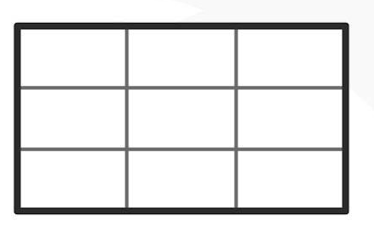
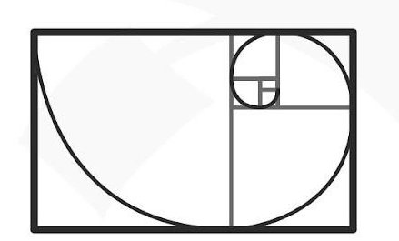
Grid Systems
Rule of Thirds
The Golden Ratio
Notes:
Rule of Thirds – This grid system splits content evenly into thirds, horizontally and vertically. You put your design elements at the intersection of those dividing lines or along one of the lines. Used effectively in (e.g.) cinema, it’s a tried-and-tested way to catch users’ eyes and access them in familiar visual terms.
The Golden Section – Or The Golden Ratio, it’s a long-established mathematical ratio used by artists and architects for over 2,000 years. Its formula is: Side A is to side B as side B is to sides A+B, which equates to a ratio of 1:1.618. Featuring frequently in nature, the golden section can please users’ eyes with organic and natural-looking design compositions.
Image from: © Daniel Skrok and Interaction Design Foundation, CC BY-SA 3.0
https://ixdf.org/literature/topics/grid-systems

Slide 9
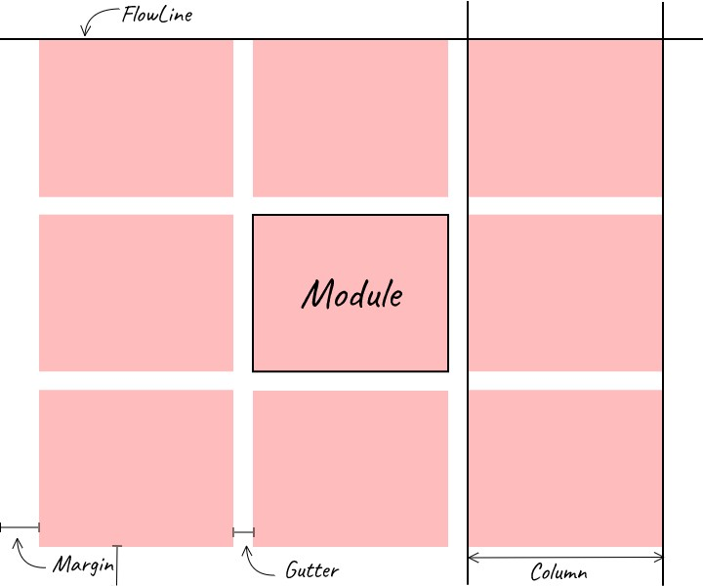
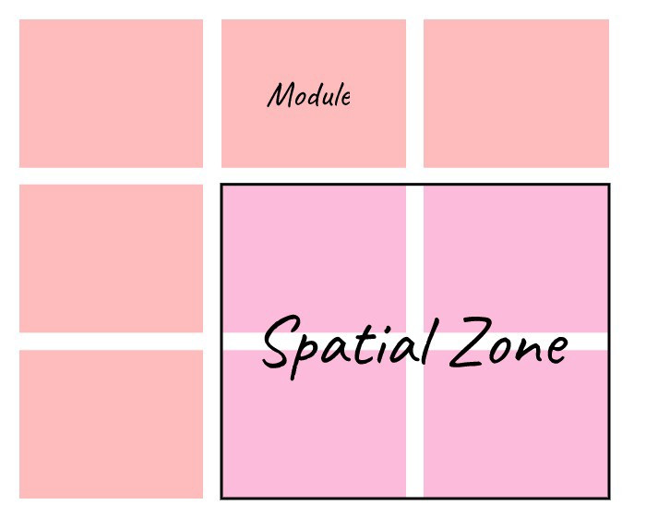
Anatomy of a Grid
Notes:
Every grid, regardless of type, shares these structural elements:
Columns — Vertical divisions that hold content. Web layouts commonly use 12 columns; mobile layouts use 4.
Gutters — The gaps between columns. Typical gutter widths are 16 px, 20 px, or 24 px. Consistent gutter widths ensure breathing room without wasting space.
Margins — The outer spacing between the grid and the viewport edge. Margins prevent content from touching the browser or device frame.
Rows — Horizontal divisions used in modular and baseline grids to create repeating vertical units.
Modules — The rectangular content areas formed by the intersection of rows and columns in a modular grid.
Spacial Zone — Groups of modules that form a distinct functional area — e.g., a sidebar, a content well, or a header.
Flowlines are horizontal axes that brake the space into horizontal divisions (rows). They provide an additional point of alignment and help to arrange elements across and down the page.
Images from
https://medium.com/gravitdesigner/grids-in-graphic-and-web-design-be20e3158efd

Slide 10
Grid Detective
Instructions
In pairs:
Look at the NBCC homepage.
Identify possible columns.
Trace invisible grid lines.
Discuss why the designer used them.
Notes:
The purpose is to train students to see grids that aren't visible.
Most professional grids disappear in the final design.
The viewer should notice organization, not the grid itself.
Allow:
3 minutes observation
3 minutes discussion
2 minute debrief

Slide 11
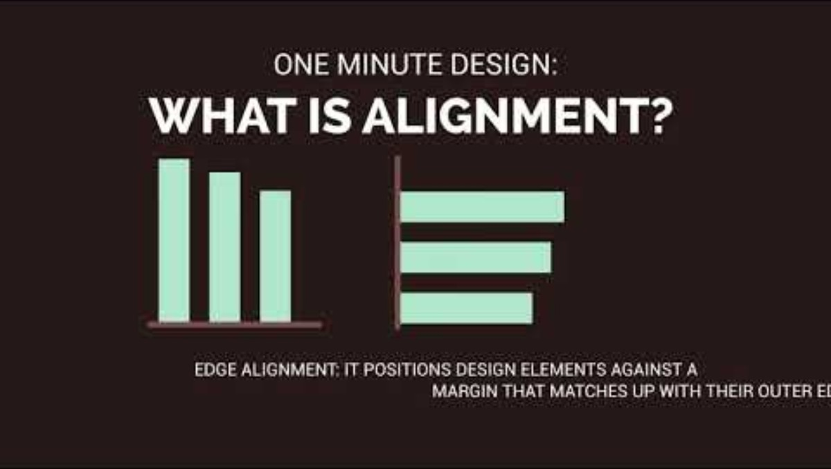
Notes:
https://www.youtube.com/watch?v=oNzT_vEp1pM&t=2s
One Minute Design: What is Alignment? – YouTube
1 minute
One Minute Design: What is Alignment?
4,572 views Oct 27, 2017 Alignment in design is important not only because it adds to the organization of a design but also enhances its comprehension and usability. It is necessary to make every element on a web page organized like header, content, footer, paragraphs, ads, text headers, and images. You neglect one element and phew… every other element might get lost into oblivion. There are a number of web pages that look cluttered and nobody understands the reason for the mess. The answer hides in mismanaged alignment. While most of the designers look into every detail of designing, alignment is somehow neglected in the process. Like, the biggest alignment mistake is to forget to include the smaller elements within the large sections of a web layout. Proper alignment makes the smaller elements more appealing and make your web page more user friendly thus ensuring calmer reading experience and more traffic to the website.

Slide 12
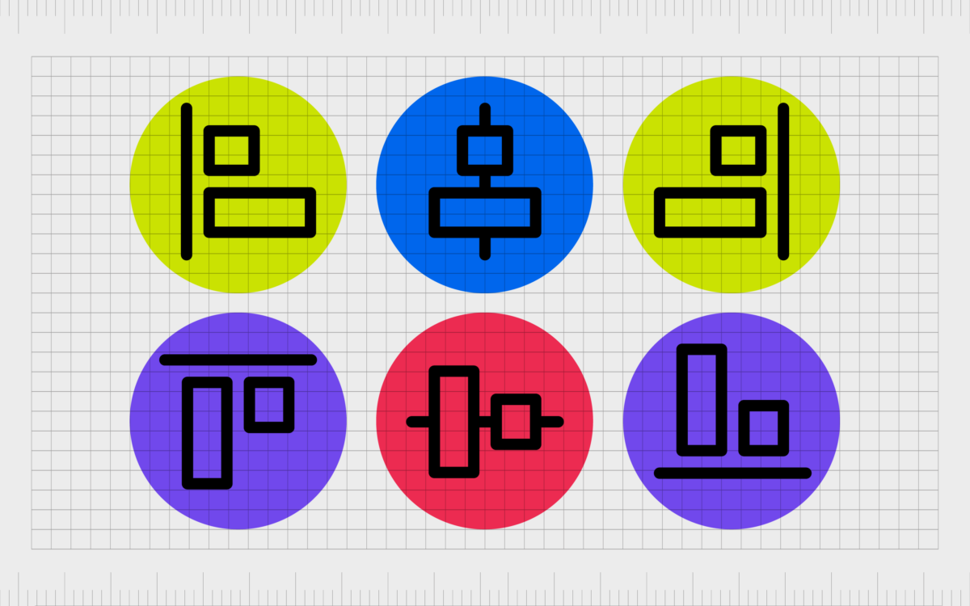
Types of Alignment
Notes:
Horizonal Alignment – Left – Centre – Right
Vertical Alignment - Top – Middle – Bottom
Edge Alignment vs centered alignment
Image from
Alignment In Graphic Design: The Alignment Principle Of Design
https://fabrikbrands.com/branding-matters/graphic-design/alignment-in-graphic-design-alignment-principle-of-design/

Slide 13
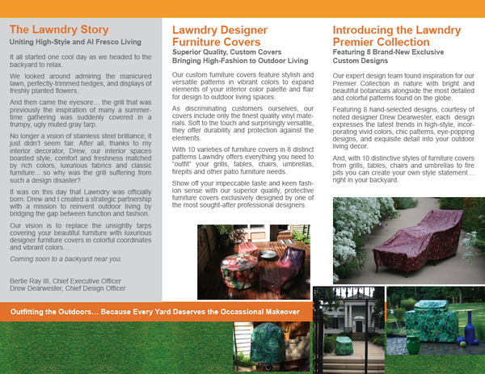
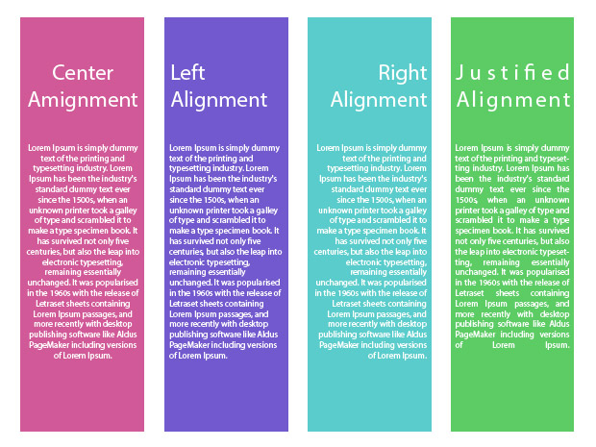
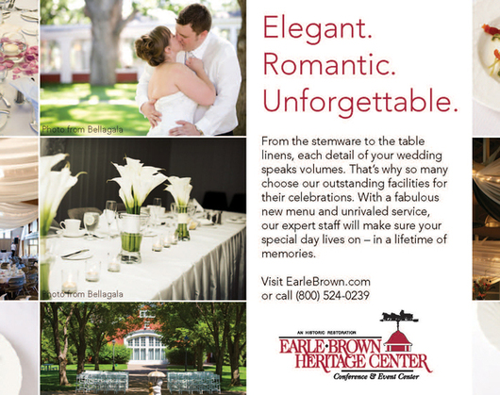

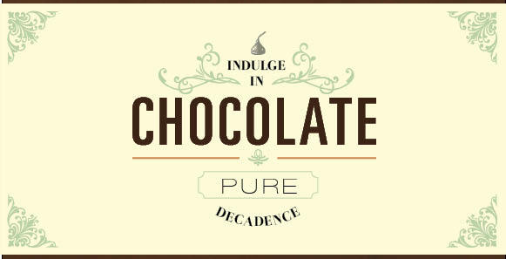
Text Alignment
Notes:
Common Types of Horizontal Alignment for Text
When dealing with alignment theory, most people immediately think of the horizontal placement of text on a page. This is only a single aspect of the alignment principles, but it’s undeniably an important one since you’ll be dealing with it anytime you work with text.
There are four common types of alignment when dealing with text placement: center, flush left, flush right and justified.
Center alignment works best when dealing with just a few short lines of text. You should never use it for full paragraphs because it makes them more difficult to read; the audience has no straight margin so their eyes must move to a new position every time they start a new line.
LEFT Text aligned against a hard left-hand margin is generally considered the strongest, “safest” choice and is the most common orientation. It results in a very comfortable, secure and conservative look (though again, there are plenty of ways to use it creatively).
RIGHT Flush right alignment is much less common than other types, so it’s often used to give elements a unique or “offbeat” look and feel. With this orientation, text is aligned against a hard right-hand margin (with the left side left “ragged”).
Like with center alignment, you should avoid using flush right on large paragraphs since the ragged left edge will make them difficult to read. With shorter lines of text, it can help give your words extra weight and importance since it requires more effort to read. It’s more interesting than centering everything, but overusing it may frustrate your reader.
Justified - With justified alignment, both the left and right sides of the text are effectively flush against hard, straight margins. This is achieved by individually adjusting the spacing of each line of text–so a line with fewer characters will be more broadly spaced, while a line with more characters will have less space between them. Ideally, the difference in space will be subtle enough that you won’t really notice the difference, but the end result will be a neat and organized look that’s more formal-looking than flush left alignment.
You’ve probably seen this technique used in books, newspapers, magazines and other publications. Justification is especially useful when working with multiple columns of text because it helps to keep them visually separate from one another as well as fit more characters into a smaller amount of space.
Images from How to use Alignment to improve your design - Graphic Design Fundamentals
https://graphicdesignfundamentals.com/how-to-use-alignment-to-improve-your-design/

Slide 14
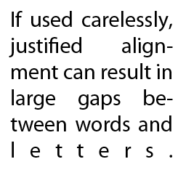
Justified complication
Notes:
Justified text comes with one major complication. If individual words are too long or the columns are too narrow, it can sometimes create large unsightly gaps of blank space. If you’re having these types of issues with justification, try using a longer line length, a smaller font, or shorter words.

Slide 15
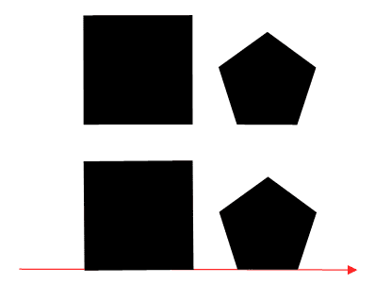
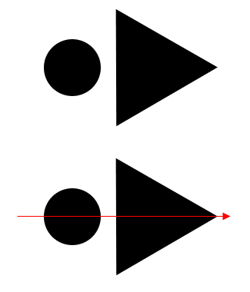
Finding the “invisible line”
Notes:
Finding the “invisible line”
Alignment (like the name suggests) is all about organizing elements relative to a line or margin. This doesn’t have to be a literal line in your design; in fact, it’s usually an invisible margin implied by the way your design is arranged.
The two basic alignment principles are edge alignment and center alignment. Each is essentially a different way of utilizing an invisible line.

Slide 16
Alignment Creates Relationships
Alignment tells viewers:
What belongs together
What is separate
Where to begin reading
How to move through a layout
Notes:
Alignment does more than make things look neat.
When elements share an alignment point, viewers assume they are connected.
For example:
A photo and caption share alignment.
A heading aligns with body text.
Navigation items align with each other.
These relationships help viewers understand information without thinking about it.

Slide 17
The Cost of Poor Alignment
Misalignment can create:
Visual confusion
Poor readability
Weak hierarchy
An unprofessional appearance
Notes:
Poor alignment is often one of the quickest ways to make a design look amateur.
Many beginning designers focus only on fonts and colours.
Professional designers often focus first on:
Alignment
Spacing
Organization
Small alignment improvements can dramatically improve a design.

Slide 18
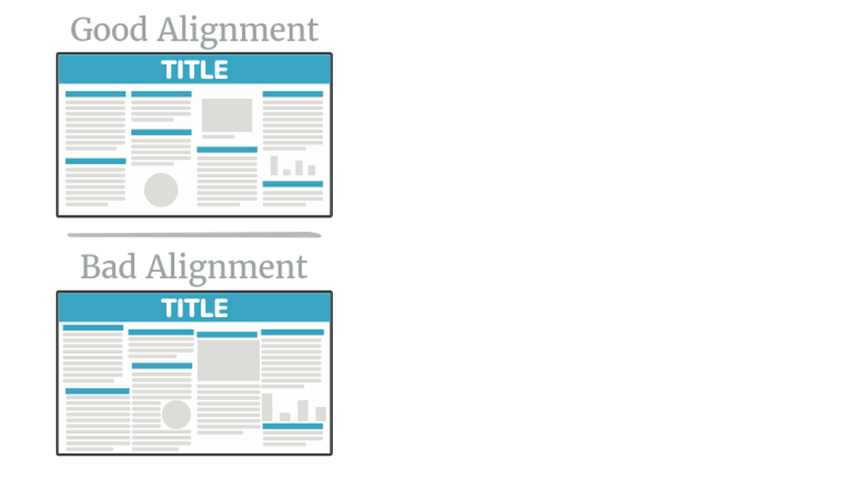
Spot the Alignment Problem
Notes:
Ask
Which feels more professional?
Why?
Which elements seem disconnected?
What would you fix first?
Notes
Students should explain their reasoning.
Avoid simple answers like:
"Because it looks better."
Encourage:
"The headline does not align with the image edge."
"The text blocks do not share a common starting point.“
Image from:
https://libguides.usc.edu.au/posters/design

Slide 19
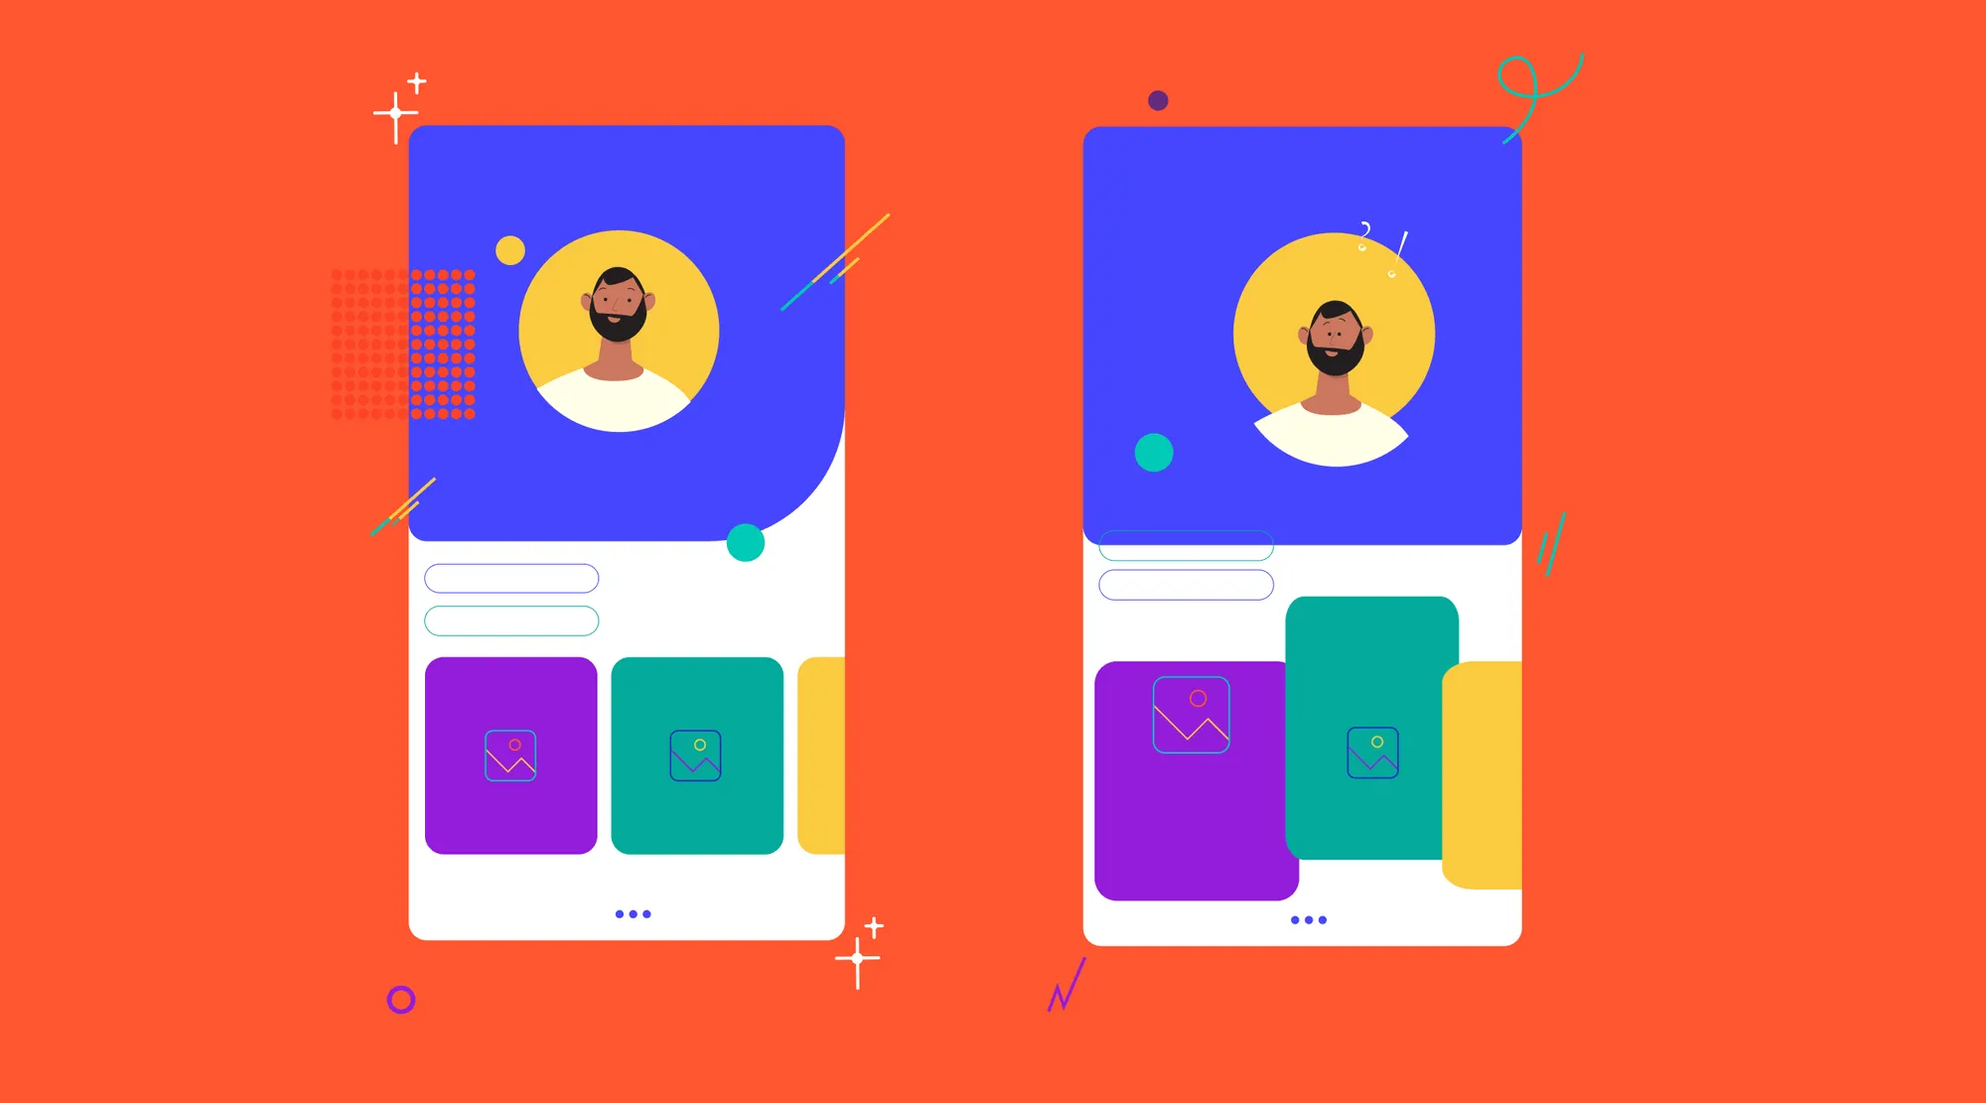
Spot the Alignment Problem
Notes:
Ask
Which feels more professional?
Why?
Which elements seem disconnected?
What would you fix first?
Notes
Students should explain their reasoning.
Avoid simple answers like:
"Because it looks better."
Encourage:
"The headline does not align with the image edge."
"The text blocks do not share a common starting point.“
Image from
How to differentiate between Good Design Vs Bad Design
https://www.fluidesigns.in/blog/how-to-differentiate-between-good-design-vs-bad-design

Slide 20
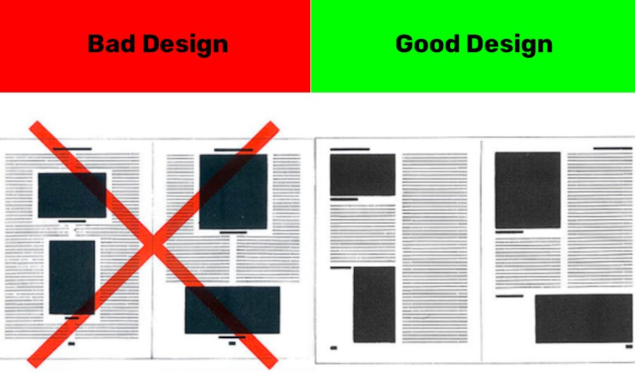
Spot the Alignment Problem
Notes:
Ask
Which feels more professional?
Why?
Which elements seem disconnected?
What would you fix first?
Notes
Students should explain their reasoning.
Avoid simple answers like:
"Because it looks better."
Encourage:
"The headline does not align with the image edge."
"The text blocks do not share a common starting point.“
Image from
https://sl.bing.net/d4Xj9xZ6SmO

Slide 21
Alignment Pitfall
Centering everything.
Center alignment has its place, but overuse equals drift and weak reading flow.
Notes:
Pitfall:
“Centering everything. Center alignment has its place, but overuse equals drift and weak reading flow.”

Slide 22
Repetition
Repetition is reusing visual elements—typefaces, colours, shapes, spacing—to create unity and a recognizable system.
Consistency
Creates unity
Establishes brand identity
Notes:
Ask “Where do your eyes go first?” often—it trains hierarchy thinking.
Definition (say):
“Repetition is reusing visual elements—typefaces, colours, shapes, spacing—to create unity and a recognizable system.”
Why it matters:
“Consistency builds trust and speeds recognition—this is how brands feel coherent across poster, web, and social.”
“Repetition sets expectations: same style = same type of content.”
How to apply:
“Pick one or two typefaces and stick to a consistent hierarchy (H1/H2/body).”
“Repeat colour roles (e.g., one accent colour always marks calls to action).”
“Repeat shapes or illustration style across components.”
What to show:
A campaign with consistent headline style/colour bar across multiple pieces.
Prompt:
“What three things could we repeat here to make this feel like a series?”

Slide 23
Rhythm Through Repetition
Repetition helps create:
Pattern
Rhythm
Predictability
Structure
Visual Rhythm Layout
Created through repeating:
Headings
Images
Shapes
Columns
Spacing
Notes:
In music, rhythm comes from repeated beats.
In design, rhythm comes from repeated visual elements.
Examples include:
Repeating shapes
Repeating colours
Repeating image styles
Repeating spacing patterns
The viewer begins to recognize these patterns and move comfortably through the design.
Visual rhythm helps guide the eye through a design.
Think about magazine layouts.
Repeated image sizes and repeated heading styles help readers move naturally from one section to another.
Without rhythm, layouts may feel random.
With rhythm, layouts feel organized and intentional.

Slide 24
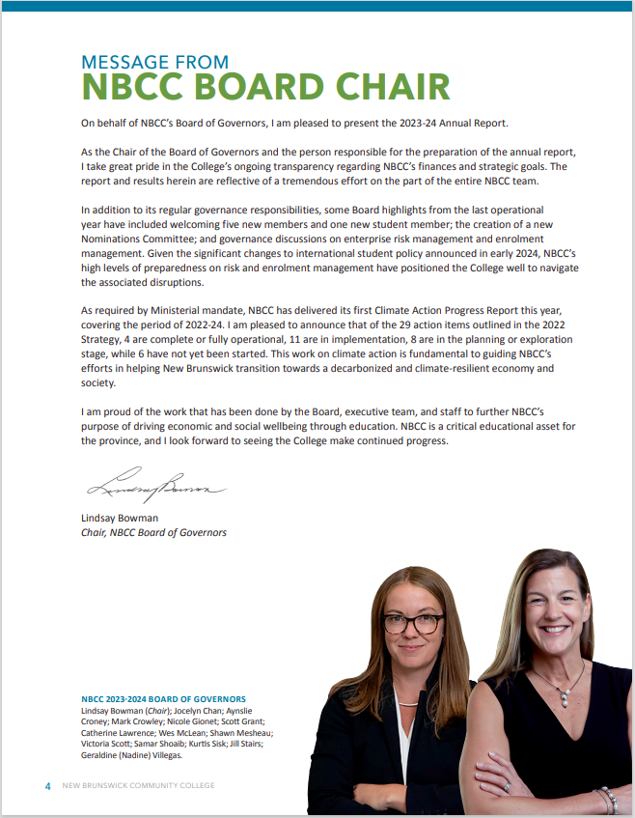
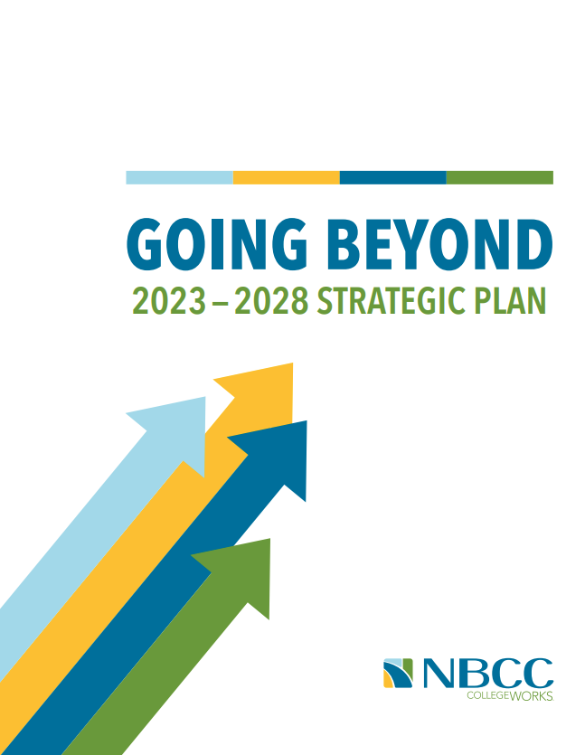
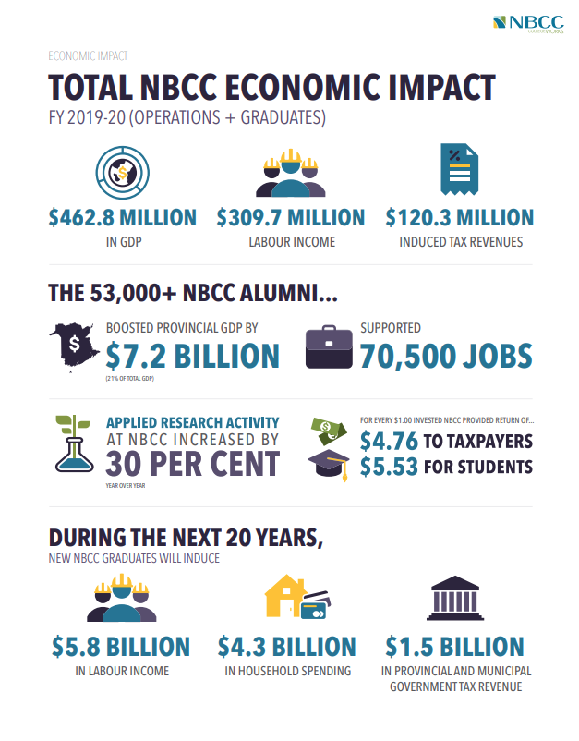
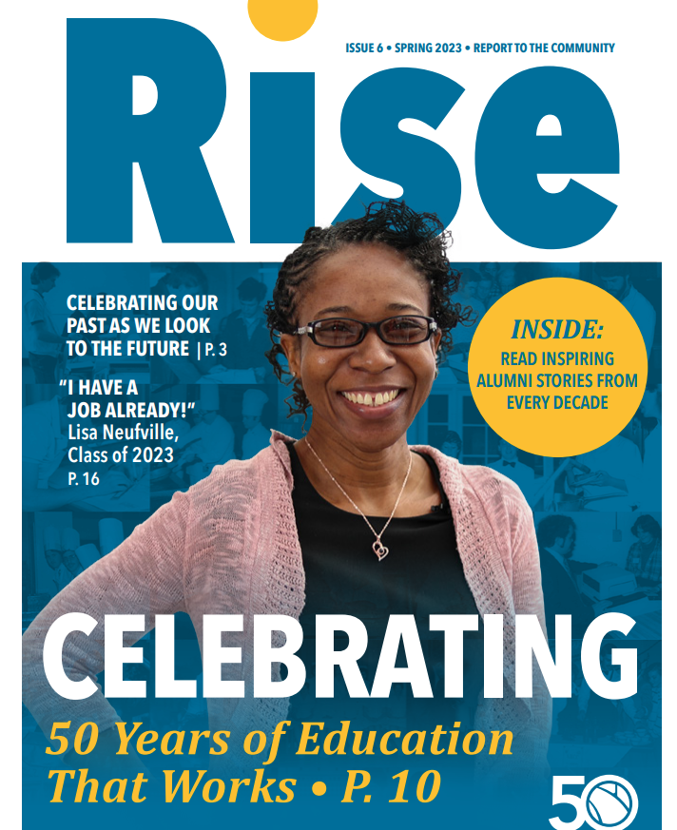
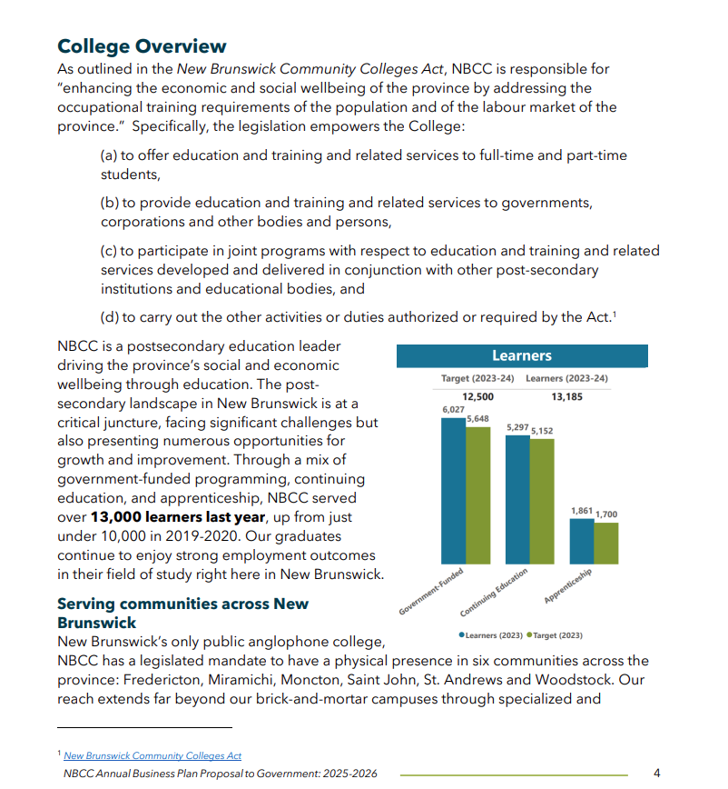

Repetition in Brand
Notes:
How to apply:
“Pick one or two typefaces and stick to a consistent hierarchy (H1/H2/body).”
“Repeat colour roles (e.g., one accent colour always marks calls to action).”
“Repeat shapes or illustration style across components.”
What to show:
A campaign with consistent headline style/colour bar across multiple pieces.
Prompt:
“What three things could we repeat here to make this feel like a series?”

Slide 25
Repetition in Brand
Notes:
How to apply:
“Pick one or two typefaces and stick to a consistent hierarchy (H1/H2/body).”
“Repeat colour roles (e.g., one accent colour always marks calls to action).”
“Repeat shapes or illustration style across components.”
What to show:
A campaign with consistent headline style/colour bar across multiple pieces.
Prompt:
“What three things could we repeat here to make this feel like a series?”

Slide 26
Repetition Beyond Branding
Repeated design choices help users:
Predict behaviour
Learn navigation
Find information quickly
Build confidence
Notes:
Repetition isn't only about branding.
It is also about usability.
When a website consistently uses:
The same button style
The same navigation placement
The same heading structure
Users quickly learn how the interface works.
Consistency reduces cognitive load.
People spend less time figuring out the interface and more time focusing on content.

Slide 27
Repetition Pitfall
Over-repetition can feel boring. Keep repetition but vary scale, crop, or colour value to add rhythm.
Notes:
Pitfall:
“Over-repetition can feel boring. Keep repetition but vary scale, crop, or colour value to add rhythm.”

Slide 28
Unity vs. Variety
The Design Balancing Act
How to Avoid Boredom
Too Little Unity → Feels chaotic
Too Much Unity → Feels boring
Good Design → Unity + Variety
Keep Repetition
Change:
Size
Scale
Crop
Position
Value
Orientation
Notes:
Designers constantly balance consistency and variety.
Without unity:
Designs feel disconnected.
Elements feel unrelated.
Without variety:
Designs become repetitive.
Viewers lose interest.
Good design combines both.
The goal is consistency with enough variation to maintain attention.
Designers rarely repeat elements exactly.
Instead, they repeat core characteristics while introducing variation.
For example:
A series of social media posts may repeat:
Brand colours
Typography
Layout structure
But vary:
Images
Headlines
Content
This creates unity without boredom.

Slide 29
Alignment + Repetition Together
Strong Design Systems Use Both
Alignment
Creates order, structure, and visual connections .
Repetition
Creates unity, consistency, and rhythm..
Together
Alignment and Repetition help designers create professional, organized, and recognizable visual communication.
Notes:
Today we explored two design principles that help transform individual elements into a cohesive system.
Although we discuss these principles separately, designers use them together.
Alignment helps organize content using invisible lines and grids that create structure and readability.
A website may use alignment to organize information.
Repetition helps create consistency, unity, and rhythm by reusing visual elements throughout a design.
The same website uses repetition to maintain a consistent experience.
When used together, alignment and repetition make designs easier to understand, easier to navigate, and more effective at communicating a message. They help create layouts that feel intentional, professional, and visually connected.

